Slide 1
HR Case Study
Matching HRs with right Interns
Project Mentor-
Mr. Rahul Pradhan
Presented by-
Nihit Jain
Utkarsh Rai
Shahaban Ali
Anujay Jain

Slide 2
OUTLINE
Problem Description
Drawbacks
Business Understanding
Project Objective
Motivation
Goals
Scope

Slide 3
OUTLINE
Implementation Process
Tools & Packages used
Data Files Description
Data Understanding
Data Pre-Processing
Data Modelling
Model Optimization

Slide 4
PROBLEM DESCRIPTION
In this problem, we have been provided with information about various internships posted on Internshala. (This includes various attributes about the internships like location, duration, start_date of internship etc.)
We have also been provided information about the students who have applied for the internship. (These include type_of_institute, current_year, academic performance of the student etc.)
Any student is free to apply for any internship on the portal.

Slide 5
DRAWBACKS
These days the selection for the internship is done manually which consumes more time.
These days the number of domains for which you can apply is increasing and the criteria for applying for an intern as well as the specification which the applicants are searching for has increased a lot thus increasing the chance of error while selecting the most suitable applicants.

Slide 6
BUSINESS UNDERSTANDING
While employers get high response to their posting, it is difficult to go through a high number of applications for the employers. They might need to go through high number of applications to shortlist the most relevant candidates. Hence an intelligent matching algorithm can help our users to get better experience and enhance the chances of meaningful profile matches.

Slide 7
PROJECT OBJECTIVE
Build the best multiple regression model that can predict the most suitable candidate for the various internship present on the Internshala, using all the other variables as the predictors.
Determine which variables must be made into indicator variables.
Determine which variables might be superfluous.

Slide 8
MOTIVATION
The main motivation for us to go for this project was that a lot of internships are provided on Internshala and a lot of applications for these internship are there, now if it the selection of the application is done manually it will consume lots of time and man-power and there are chances of human error. It is not possible to reduce the error of selection completely but if we can design a programme to select the most suitable candidate for a given internship then we ca reduce the time consumed and the workload and as it is being done by a machine the chances of error will also will be reduced and that is our goal.

Slide 9
GOALS
To reduce the total number of applicants a company has to go over during the selection for the internship.
To reduce the chances of error of selection a less suitable applicant when a more suitable one is present.

Slide 10
SCOPE
The scope of our analysis is that we can reduce the workload for the company while selecting the most suitable interns for them among all the applicants. This is so, as based on our analysis we can find out those attributes which are most significant for the selection of the applicants thus helping us to focus on only those attributes rather than wasting our effort and time on other unrelated areas.
Thus it will help as follows:
Reduce the workload.
Reduce the time consumed while selecting the suitable candidates.
It can also be used by the applicants to know which are the more suitable internship for them.

Slide 11
IMPLIMENTATION PROCESS
Data Collection & Understanding
Data Pre-Processing
Data Modeling & Optimization

Slide 12





TOOLS

Slide 13



PACKAGES
Cleaning with R:
Sqldf
Dummies
Lubridate
Modeling with Python:
Pandas
NumPy
Scikit-learn
Matplotlib

Slide 14
DATA FILES DESCRIPTION
Internship.csv - includes the details of all the internships posted on Internshala. These details are filled by the company floating the Internship. Each row represents one internship.
Student.csv - includes details of the students applying for the internship. These details have been filled by the student. Each row represents an experience of the student. In case the student has not filled any experience, there would be only one row containing details of student.
test.csv & train.csv - include the application details (as applied by student) and the shortlist outcome

Slide 15
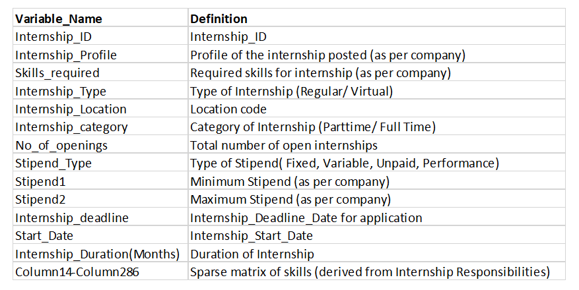
Internship.csv

Slide 16
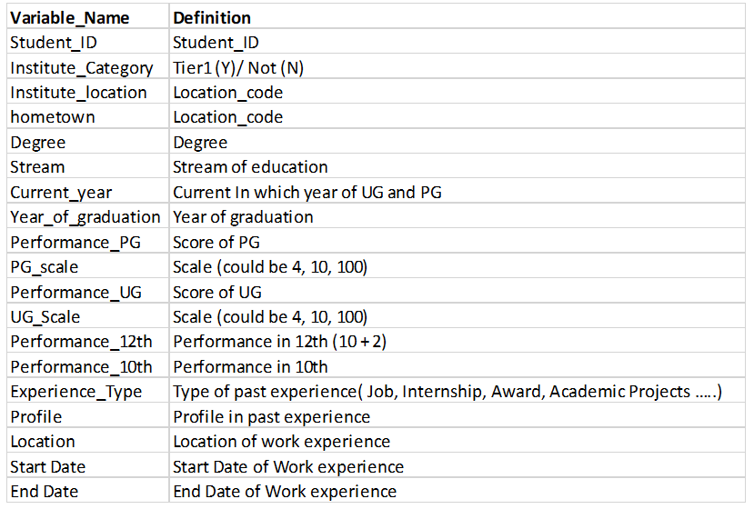
Student.csv

Slide 17
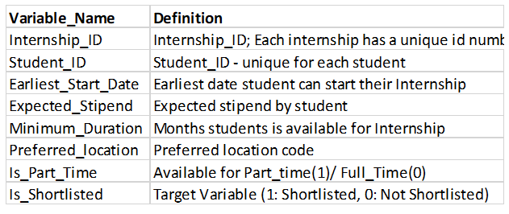
train.csv

Slide 18
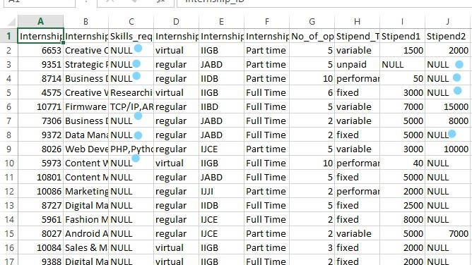
Data Pre-Processing

Slide 19
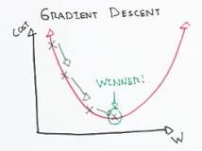
Data Modeling
Gradient descent is an optimization algorithm used to minimize some function by iteratively moving in the direction of steepest descent as defined by the negative of the gradient. In machine learning, we use gradient descent to update the parameters of our model.

Slide 20
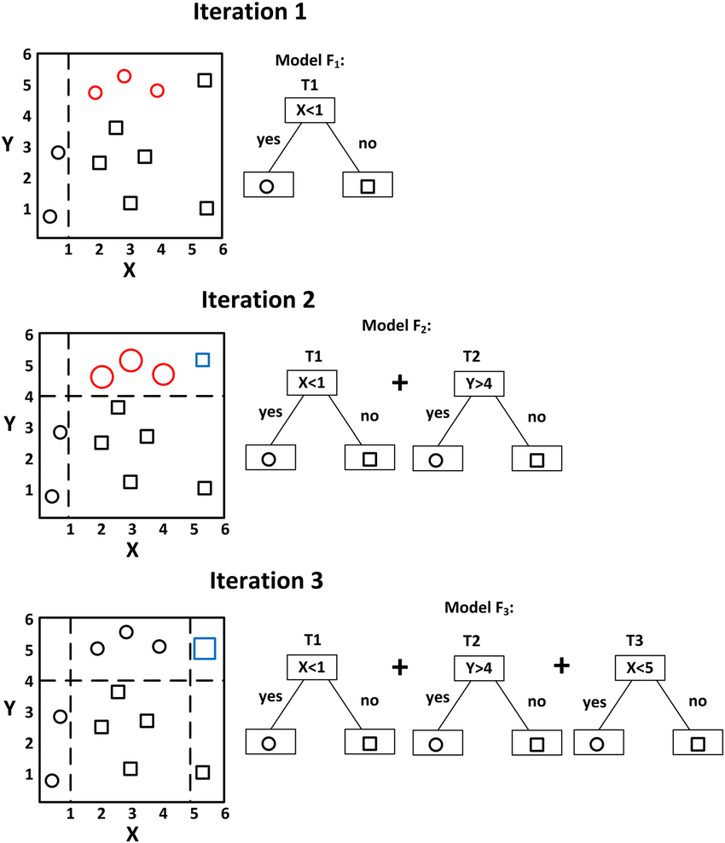
Model Optimization
Gradient boosting is a machine learning technique for regression and classification problems, which produces a prediction model in the form of an ensemble of weak prediction models, typically decision trees.

Slide 21
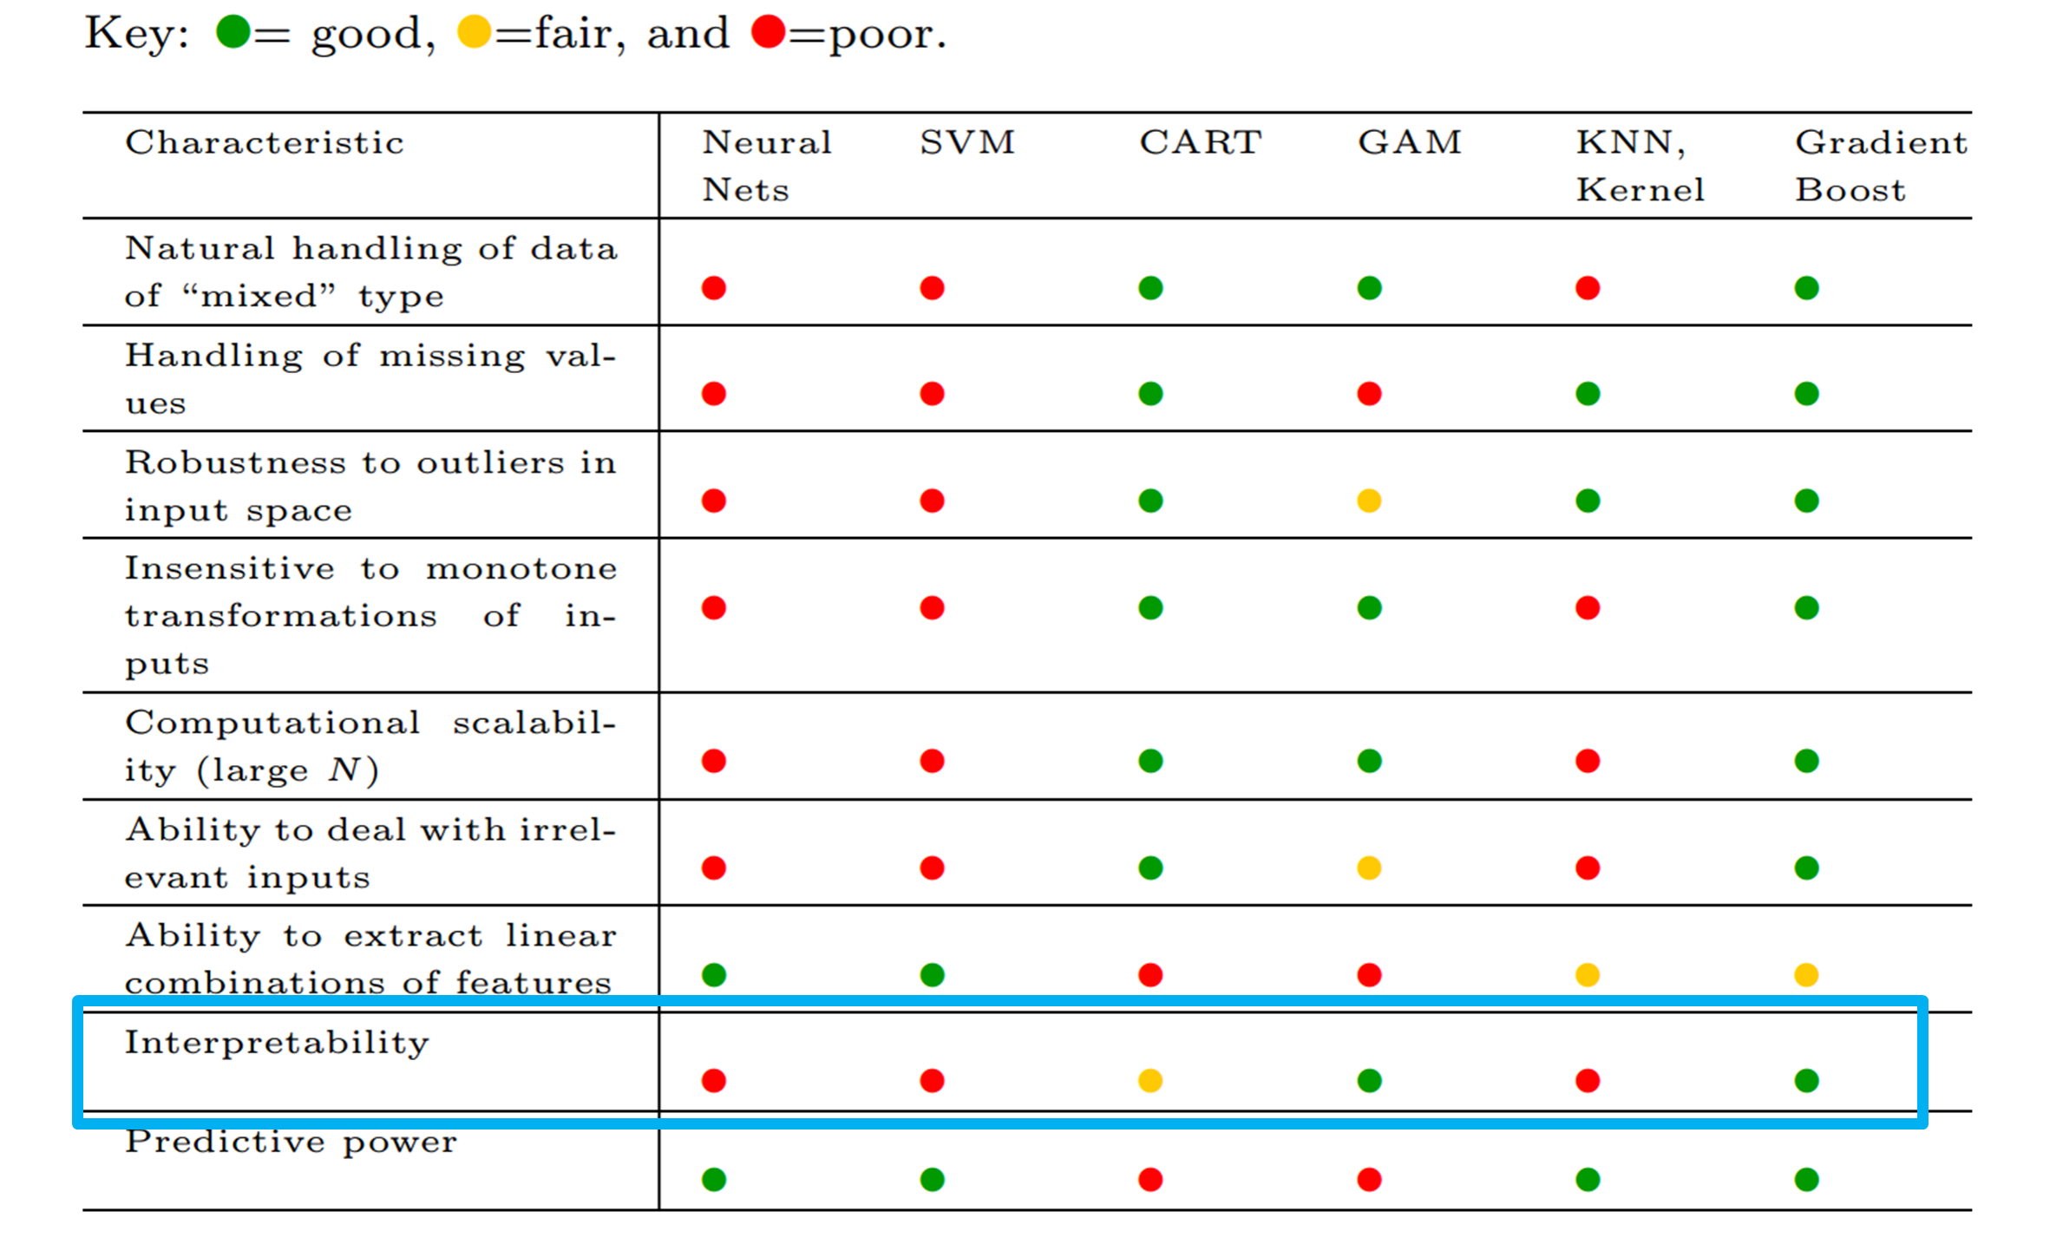

Slide 22
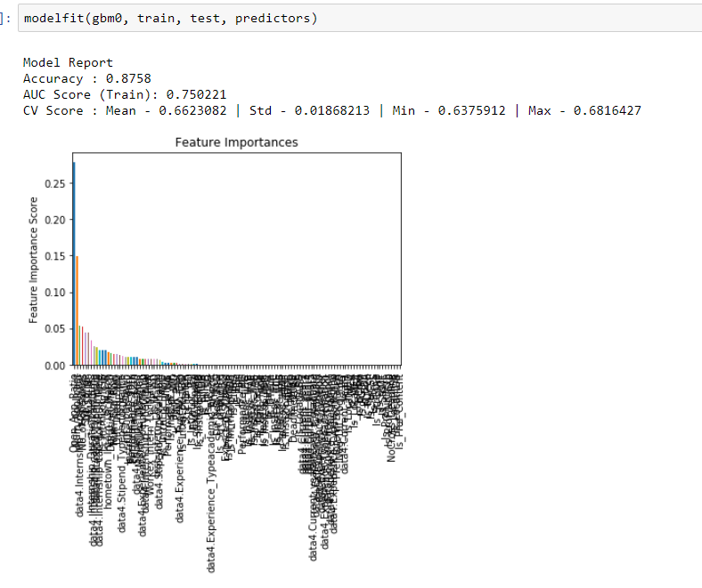
Model Fitting

Slide 23
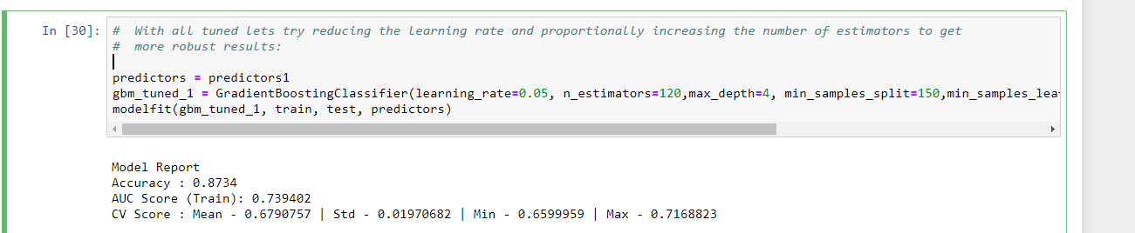
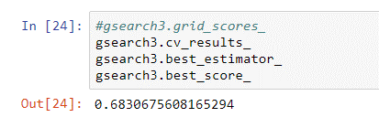

Slide 24


